Slide 1
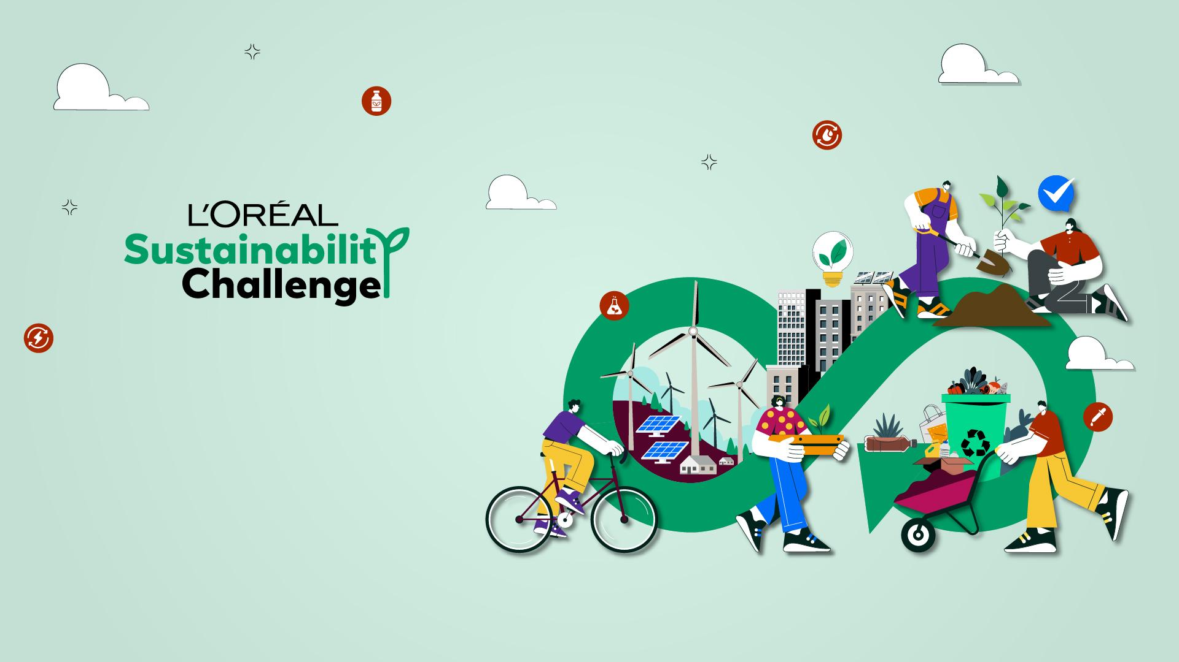
Team name: She thinks

Slide 2


🌍 Theme: “Beauty Beyond Borders”
(An ecosystem that unites People, Planet, and Product in one connected initiative)
People:
Pillar: Empowering Vulnerable Communities through Beauty Skills
Idea – Beauty Skill Pods (BSPs):
👥 Establish micro-skill hubs in Tier-2/3 cities & rural areas where unemployed women, differently-abled individuals, and marginalized youth are trained in eco-beauty practices (natural cosmetics, sustainable packaging assembly, digital beauty services).
🌍💡Each hub doubles as a tele-beauty center (using low-cost AR/AI mirrors) where local people provide remote beauty consulting to global consumers → creating global income opportunities.
Impact:
Direct employment for 10,000+ vulnerable individuals in 3 years.
👩‍👩‍👦 Bridges urban-rural economic divide while building inclusivity in the beauty industry

Slide 3


Planet:
Pillar: Green Impact through Circular Beauty Systems
Idea – BioCapsule Packaging:
♻️🌾Introduce biodegradable “Beauty Capsules” made from seaweed + agri-waste composites (innovative material, dissolves in water/soil in 45 days).
🌱Used for shampoos, serums, and creams → no plastic bottles needed.
📦🚚Integrated with a Return & Regrow Program: consumers can return empty capsule trays via Quick Commerce platforms (Zepto, Blinkit) → capsules are composted and linked to local urban farming collectives.
Impact:
🗑️Reduces >80% plastic waste in 5 years.
🔄🥬/🌿Creates a closed-loop cycle where beauty waste = food for farms.

Slide 4

Product:
Pillar: Science + Sustainability + Personalization
Idea – AuraSkin AI (Next-Gen Personal Beauty Device):
🖐️🔬A pocket-sized handheld device with skin sensors & AI that:
Scans skin in 30 seconds (pigmentation, pollution damage, hydration).
💊☀️Recommends & dispenses micro-doses of beauty capsules tailored to user needs (like a Nespresso machine for skincare).
♻️Powered by solar charging strip + recyclable components.
🤝 Linked to a digital sustainability badge: users track their personal carbon & plastic savings → gamified rewards.
Impact:
👩‍⚕️Personalized skincare at scale.
🌍Builds consumer loyalty while ensuring measurable sustainability footprint.

